Slide 1

SEXUALLY EXPLICIT MATERIALS
Notes:
Commonly accepted ethical principles:
Societal concensus
Character education
Sexually transmitted infections
Sexual activity between unmarried partners
Sodomy:
Question of privacy
Discrimination against homosexuals
Contraception
Abortions:
Determining when life begins
Rights of a woman
Rights of the unborn
Amniocentesis:
Risk of procedure
Increased likelihood of abortion
Fetal tissue implantation:
Abortion debate
Medical value
Prostitution
In vitro fertilization
Genetic engineering:
Sexual responsibility to a partner

Slide 2
Ethics
Moral & immoral
Ethical principles
  Nonmaleficence -- do no harm
  Beneficience --do good
  Autonomy/liberty -- people should be free to make their own decisions
  Justice/fairness
  Social utility -- what is best for society
Ethical dilemma
Be sure to know application of different ethical principles
Notes:
Ethics refers to a system by which a society decides whether an action is moral or immoral.
Ethical Principles:
Nonmaeficence (do no harm)
Beneficience (do good)
Autonomy/liberty (people should be free to make their own decisions)
Justice/fairness
Social utility (what is best for society)
Ethical dilemmas:When 2 or more ethical principles work in opposing fashion in a particular situation resulting in bewilderment regarding what is moral and immoral.
Rule ethics
Situation ethics

Slide 3
Sexual Consumerism
U.S. sex industry → multi-billion-dollar
As a nation, ambivalent about sexually explicit material (SEM) & prostitution
  viewed as immoral, exploitative, harmless, erotic, or something that cannot be regulated
Notes:
Annual business in sexually explicit material roughly $10-$14 billion in U.S.
Playboy, Penthouse sell 5 million copies a month
The Internet
“sex” is most frequent search term
Sexually explicit videos
700 million rented/bought annually: 15-25% of videos sold

Slide 4
Terms related to SEM
Obscenity - legal term
Erotica
Pornography
Sexually explicit material
Notes:
Media images can negatively distort body image and self-esteem.
Many ads use sexual imagery to attract attention and stimulate senses.
Media fail to depict safer sex practices.
Television advertising and programming:
Commercials
Soap operas
Cable television
Literature:
Books
Magazines
On-line material:
Web sites and email
X-rates computer games
DefinitionsL
Obscenity:
Work appeals to purient interest
Depicts or describes sexual conduct patently and legally offensive
Work lack literary, artistic, political or scientific value
Erotica:
Sexually oriented material that can be evaluated positively
No externally used products can enlarge the penis or breasts.
Some countries ban any sexually explicit materials.
Is it pornography or erotica?
Erotica: from Greek for “love poem”
positive evaluation of sexually explicit material
May have artistic value, involve mutuality, respect
Pornography: from Latin for “filth”
negative evaluation of sexually explicit material
Might include anything that depicts sexuality and causes sexual arousal in the viewer
Sexually explicit material: neutral term
Any material that depicts sexuality or causes sexual arousal

Slide 5
Internet and SEM
Triple A engine
  Access
  Affordability
  Anonymity (or the perception of)

Slide 6
Themes in SEM
Themes in SEM and mainstream media are similar
  Innuendoes, subordination of women, violence
Four main themes in SEM
  Diverse sexual activity
  High levels of sexual desire
  Pleasure as purpose of sexual activity
  Many readily available sexual partners

Slide 7
Porn vs Reality
http://www.huffingtonpost.com/2013/07/30/porn-vs-real-sex-video_n_3677746.html

Slide 8
The Effects of SEM
Sexual expression
  Can enhance pleasure, knowledge, safe sex
Variation in personal emotional response
Unclear link between SEM, sexual aggression, sex discrimination
Wolf’s contention that it affects what men are attracted to
  “real women” no longer appealing
Notes:
4

Slide 9
Porn stats (2017 stats)
PornHub claims 28.5 billion total visits
  81 million a day, almost 4 million an hour, 56,000 a minute
Average site visit lasts 10 minutes
Visits over 10 minutes tend to be from people in the South
Users - 75% male; 25% female
  Reference: https://www.psychologytoday.com/us/blog/all-about-sex/201803/surprising-new-data-the-world-s-most-popular-porn-site

Slide 10
Porn is everywhere (2015 data)
Pornhub had 87,849,731,608 pornographic videos viewed on its site
The equivalent of 12 videos per person on the entire planet.
And that's just one site.
The US accounts for 41% of PornHub’s traffic

Slide 11
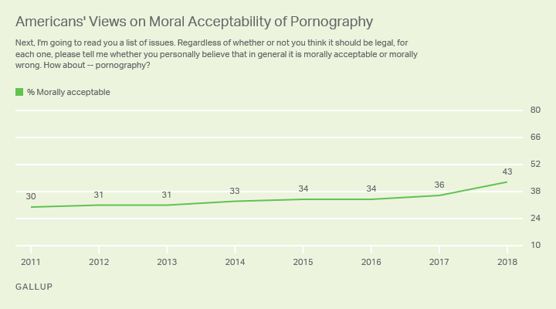
Notes:
https://news.gallup.com/poll/235280/americans-say-pornography-morally-acceptable.aspx

Slide 12
Other issues
Sex addiction is a controversial diagnosis
Addiction to SEM is also
Concern about exposure of children to SEM

Slide 13
Porn Addiction
  Is Porn Addictive?
  https://www.youtube.com/watch?v=EBSG98qzaPc
  Controversy:
  High levels of sexual fantasies and activities can be a problematic behavior (hypersexuality)
  Not included as a sexual disorder in DSM 5
  Some believe that there is enough research to support hypersexuality as a sexual health disorder (Reid and Kafka, 2014)
  Others believe that normal behaviors – like sexual behavior – should not be pathologized and that distinguishing between high levels of desire and pathological levels is difficult
Notes:
This slide lists some of the points I covered on the previous slide and also has the link to a Laci Green video that conveys these points as well.

